Slide 1
Changes in number of International students in Australia
By: Amelia Nguyen

Slide 2
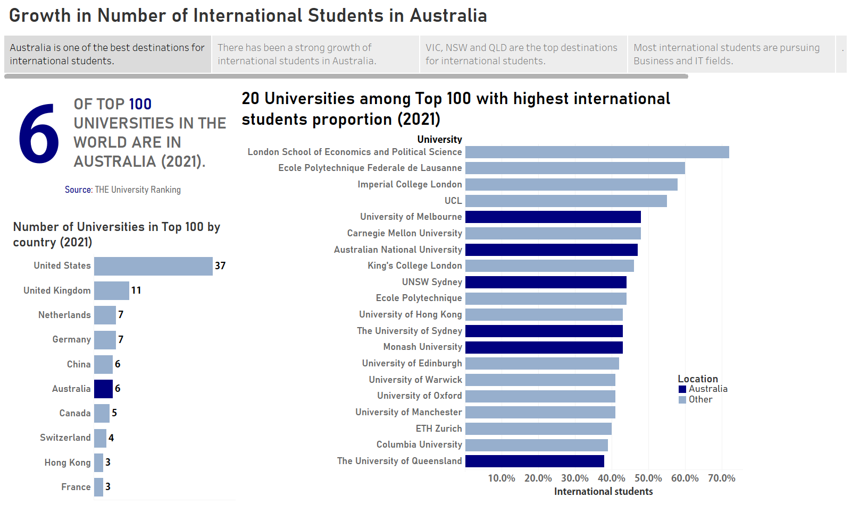

Slide 3
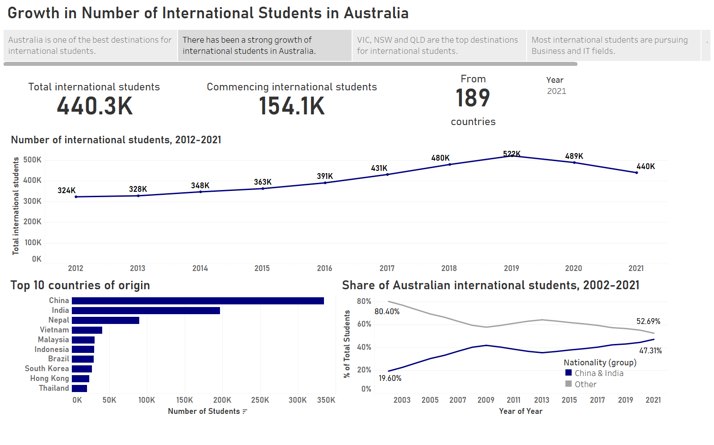

Slide 4
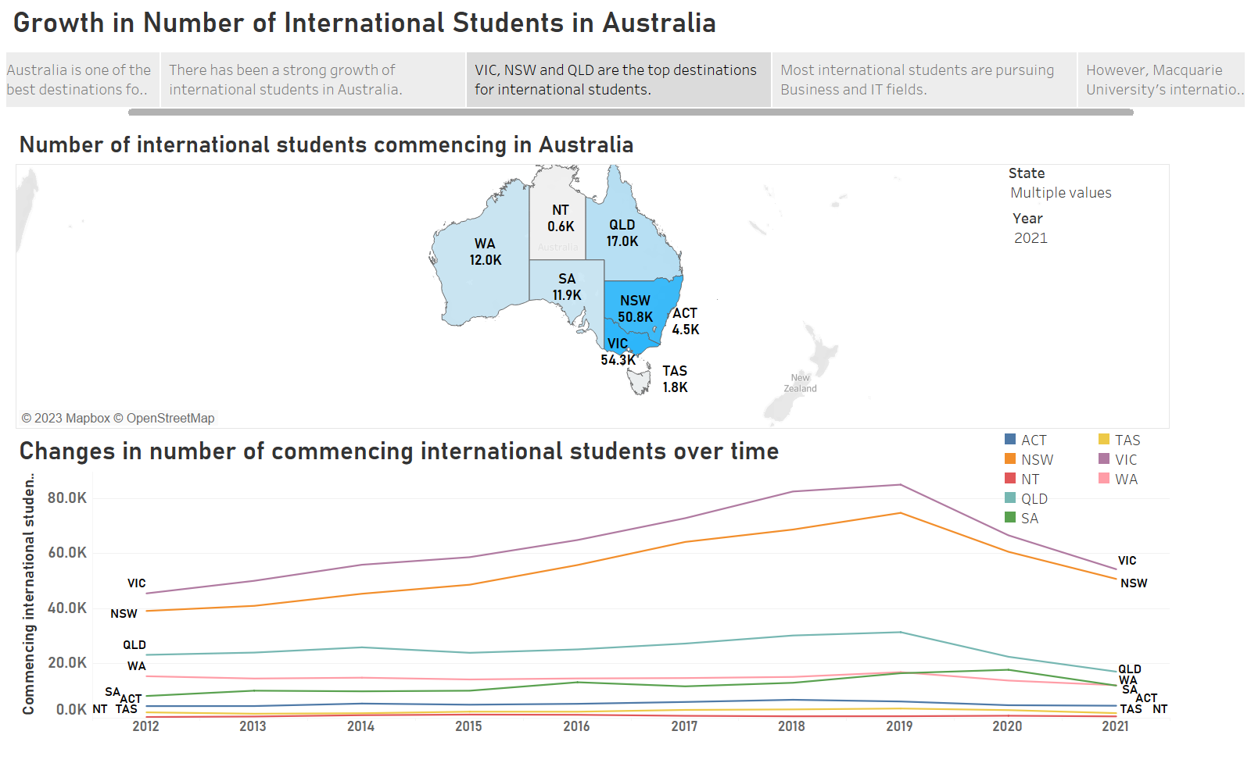

Slide 5
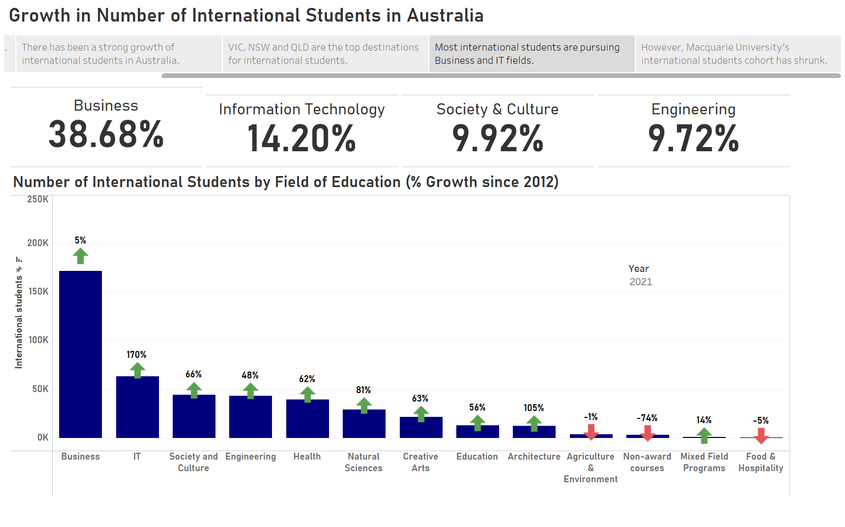

Slide 6
